Slide 1
Design Theory for Relational Databases
Functional Dependencies Decompositions分解 Normal Forms正规

Slide 2
Functional Dependencies
X->Y is an assertion断言about a relation R that whenever two tuples of R agree on all the attributes of X, then they must also agree on all attributes in set Y.
Say “X->Y holds in R.”
Convention: …, X, Y, Z represent sets of attributes; A, B, C,… represent single attributes.
Convention: no set formers in sets of attributes, just ABC, rather than {A,B,C}.

Slide 3
Splitting Right Sides of FD’s
X->A₁A₂…A_{n} holds for R exactly when each of X->A₁, X->A₂,…, X->A_{n} hold for R.
Example: A->BC is equivalent to A->B
and A->C.
There is no splitting rule for left sides.
We’ll generally express FD’s with singleton单例 right sides.

Slide 4
Example: FD’s
Drinkers(name, addr, beersLiked, manf, favBeer)
Reasonable FD’s to assert断言:
name -> addr favBeer
Note this FD is the same as name -> addr and name -> favBeer.
beersLiked -> manf

Slide 5
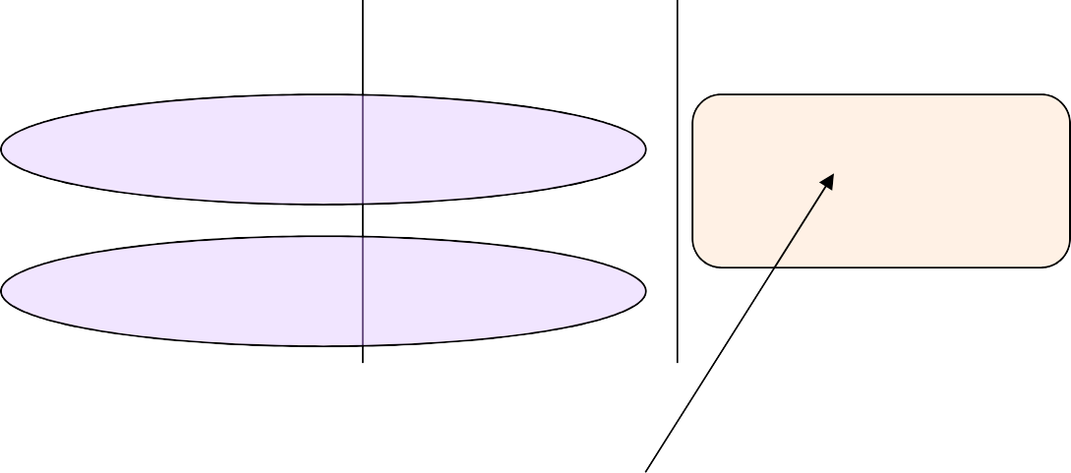
Example: Possible Data
name
addr
beersLiked manf favBeer
Janeway Janeway Spock
Voyager Voyager Enterprise
Bud WickedAle Bud
A.B.
Pete’s A.B.
WickedAle WickedAle Bud
Because name -> addr
Because name -> favBeer
Because beersLiked -> manf

Slide 6
Keys of Relations
K is a superkey for relation R ifK functionally determines决定all of R.
K is a key for R if K is a superkey, but no proper subset of K is a superkey.

Slide 7
Example: Superkey
Drinkers(name, addr, beersLiked, manf, favBeer)
{name, beersLiked} is a superkey because together these attributes determine all the other attributes.
name -> addr favBeer
beersLiked -> manf

Slide 8
Example: Key
{name, beersLiked} is a key because neither {name} nor {beersLiked} is a superkey.
name doesn’t -> manf; beersLiked doesn’t
-> addr.
There are no other keys, but lots of superkeys.
Any superset of {name, beersLiked}.

Slide 9
Where Do Keys Come From?
Just assert a key K.
The only FD’s are K-> A for all attributes A.
Assert FD’s and deduce the keys by systematic exploration.

Slide 10
More FD’s From “Physics”
Example: “no two courses can meet in the same room at the same time” tells us: hour room -> course.

Slide 11
Inferring推断 FD’s
We are given FD’s X₁ -> A₁, X₂ -> A₂,…, X_{n} -> A_{n}, and we want to know whether an FD Y-> B must hold in any relation that satisfies the given FD’s.
Example: If A-> B and B-> C hold成立, surely A-> C holds, even if we don’t say so.
Important for design of good relation schemas.

Slide 12
Inference Test
To test if Y-> B, start by assuming two tuples agree in all attributes of Y.
Y
0000000. . . 0
00000?? . . . ?

Slide 13
Inference Test – (2)
Use the given FD’s to infer that these tuples must also agree in certain other attributes.
If B is one of these attributes, then Y-> B
is true.
Otherwise, the two tuples, with any forced equalities, form a two-tuple relation that proves Y-> B does not follow from the given FD’s.

Slide 14
Closure Test
An easier way to test is to compute the
Closure 闭包 of Y, denoted Y⁺.
Basis: Y⁺ = Y.
Induction: Look for an FD’s left side X that is a subset of the current Y⁺. If the FD is X-> A, add Ato Y⁺.

Slide 15
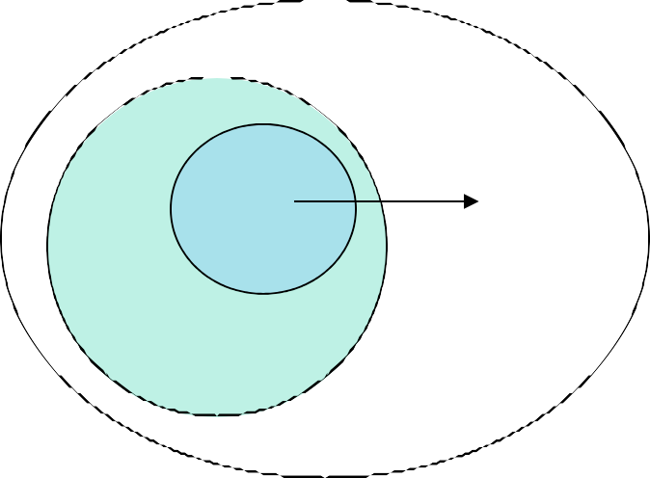
X
A
_{Y}+
new Y⁺

Slide 16
Finding All Implied FD’s
Motivation: “normalization,” the process where we break a relation schema into two or more schemas.
Example: ABCD with FD’s AB->C, C->D, and D->A.
Decompose into ABC, AD. What FD’s hold in
ABC?
Not only AB->C, but also C->A!

Slide 17



Why?
ABCD a₁b₁cd₁ a₂b₂cd₂
d₁=d₂ because
C-> D
a₁=a₂ because
D-> A
comes from
ABC
a₁b₁c a₂b₂c
Thus因此, tuples in the projection with equal C’s have equal A’s; C-> A.
17

Slide 18
Basic Idea
Start with given FD’s and find all nontrivial 非平凡的 FD’s that follow from the given FD’s.
Nontrivial = right side not contained in the left.右侧不包含在左侧
Restrict to those FD’s that involve only attributes of the projected投影 schema.

Slide 19
Simple, Exponential Algorithm指数算法
For each set of attributes X, compute X⁺.
Add X->A for all A in X⁺ - X.
However, drop XY->A whenever we discover X->A.
Because XY->A follows from X->A in any projection.
Finally, use only FD’s involving projected attributes.

Slide 20
A Few Tricks
No need to compute the closure of the empty set or of the set of all attributes.
If we find X⁺ = all attributes, so is the closure of any superset of X.

Slide 21
Example: Projecting FD’s
ABC with FD’s A->B and B->C. Project onto AC.
A+=ABC; yields 产生A->B, A->C.
We do not need to compute AB+ or AC+.
B+=BC; yields B->C.
C+=C; yields nothing.
BC+=BC; yields nothing.

Slide 22
Example -- Continued
Resulting FD’s: A->B, A->C, and B->C.
Projection onto AC: A->C.
Only FD that involves a subset of {A,C}.

Slide 23
A Geometric View of FD’s
Imagine the set of all instances 实例 of a particular relation.
That is, all finite有限 sets of tuples that have the proper number of components成分.
Each instance is a point in this space.

Slide 24
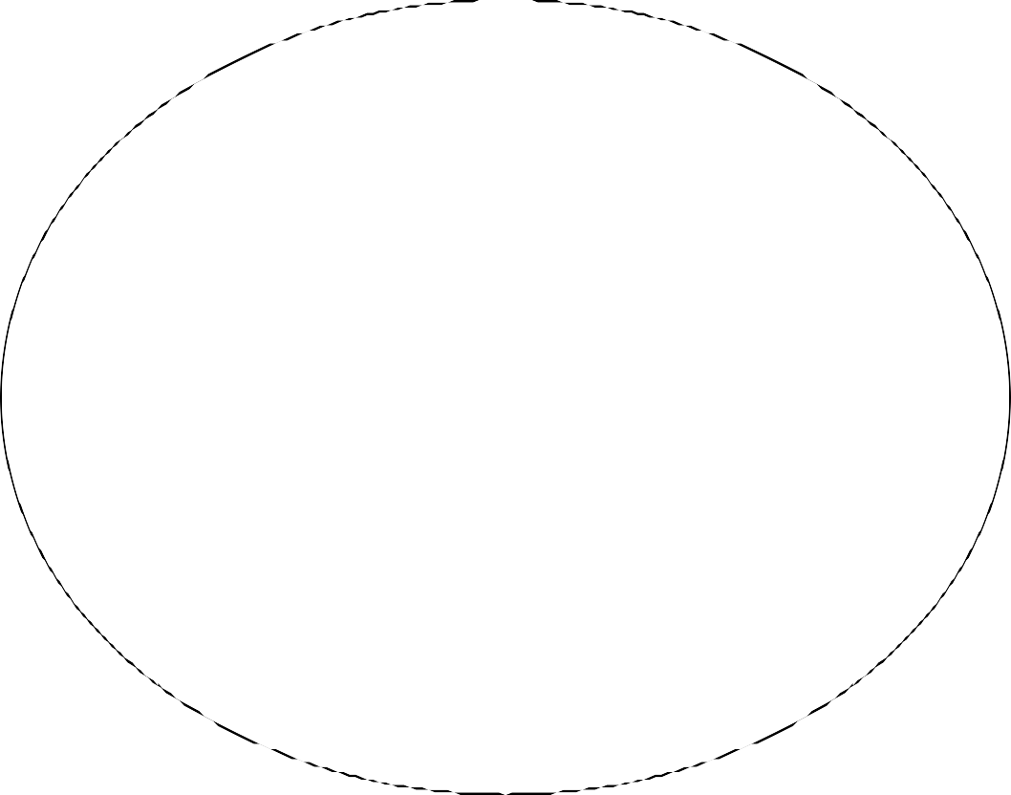
Example: R(A,B)
{(1,2), (3,4)}
{}
{(5,1)}
{(1,2), (3,4), (1,3)}

Slide 25
An FD is a Subset of Instances
For each FD X-> A there is a subset of all instances that satisfy the FD.
We can represent an FD by a region in the space.
Trivial FD = an FD that is represented by the entire space.
Example: A-> A.

Slide 26
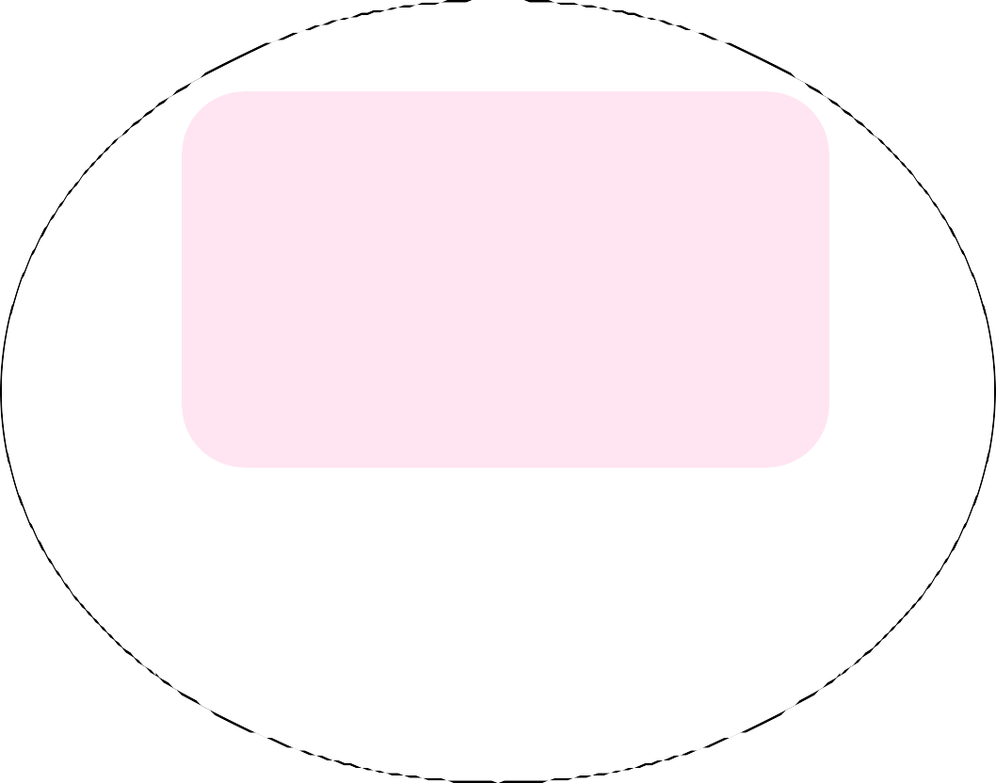
Example: A -> B for R(A,B)
{(1,2), (3,4)}
A -> B
{}
{(5,1)}
{(1,2), (3,4), (1,3)}

Slide 27
Representing Sets of FD’s
If each FD is a set of relation instances, then a collection of FD’s corresponds to the intersection交集 of those sets.
Intersection = all instances that satisfy all of the FD’s.

Slide 28
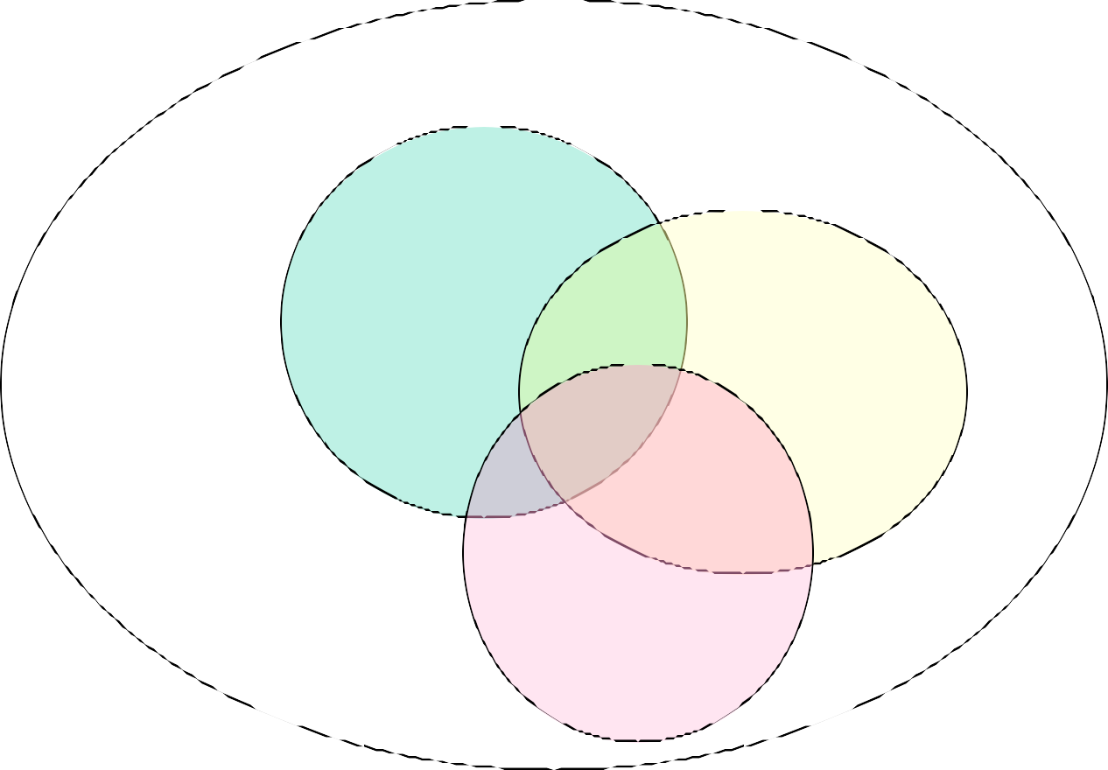
Example
Instances satisfying A->B, B->C, and CD->A
A->B
B->C
CD->A

Slide 29
Implication含义 of FD’s
If an FD Y-> B follows from FD’s
X₁ -> A₁,…,X_{n} -> A_{n}, then the region in the space of instances for Y-> B must include the intersection of the regions for the FD’s X_{i}-> A_{i}.
That is, every instance satisfying all the FD’s X_{i}-> A_{i} surely satisfies Y-> B.
But an instance could satisfy Y-> B, yet not be in this intersection.

Slide 30
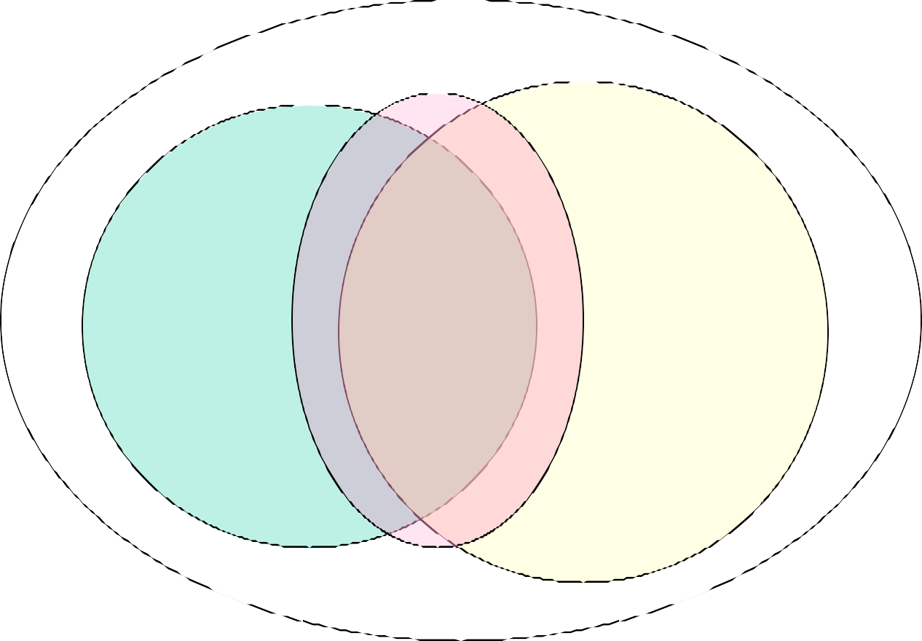
Example
A->B A->C
B->C

Slide 31
Relational Schema Design
Goal of relational schema design is to avoid anomalies异常and redundancy冗余.
Updateanomaly更新异常：one occurrence of a fact is changed, but not all occurrences.
Deletionanomaly删除异常： valid fact is lost when a tuple is deleted.

Slide 32
Example of Bad Design
Drinkers(name, addr, beersLiked, manf, favBeer)
name Janeway
addr Voyager
beersLiked manf favBeer Bud A.B. WickedAle
Janeway Spock
???
Enterprise
WickedAle Pete’s ??? Bud ??? Bud
Data is redundant, because each of the ???’s can be figured out by using the FD’s name -> addr favBeer and beersLiked -> manf.

Slide 33
This Bad Design Also Exhibits Anomalies
name Janeway
addr Voyager
beersLiked Bud
manf
favBeer
A.B. WickedAle
Janeway Spock
Voyager Enterprise
WickedAle Bud
Pete’s WickedAle
A.B. Bud
Update anomaly: if Janeway is transferred to Intrepid, will we remember to change each of her tuples?
Deletion anomaly: If nobody likes Bud, we lose track of the fact that Anheuser-Busch manufactures Bud.

Slide 34
Boyce-Codd Normal Form
We say a relation R is in BCNF if whenever X->Y is a nontrivial非平凡 FD that holds in R, X is a superkey.
Remember: nontrivial means Y is not contained in X.
Remember, a superkey is any superset of a key (not necessarily a proper superset).

Slide 35
Example
Drinkers(name, addr, beersLiked, manf, favBeer) FD’s: name->addr favBeer, beersLiked->manf
Only key is {name, beersLiked}.
In each FD, the left side is not a superkey.
Any one of these FD’s shows Drinkers is not in BCNF

Slide 36
Another Example
Beers(name, manf, manfAddr)
FD’s: name->manf, manf->manfAddr
Only key is {name} .
name->manf does not violate BCNF, but manf->manfAddr does.

Slide 37
Decomposition分解 into BCNF
Given: relation R with FD’s F.
Look among the given FD’s for a BCNF violation X->Y.
If any FD following from F violates BCNF, then there will surely be an FD in F itself that violates BCNF.
Compute X⁺.
Not all attributes, or else X is a superkey.

Slide 38
Decompose R Using X -> Y
Replace R by relations with schemas:
1. R₁ = X⁺.
2. R₂ = R– (X⁺ – X).
Proectj given FD’s F onto the two new relations.

Slide 39

Decomposition Picture
R₁
X
X⁺-X
R-X⁺
R₂
R

Slide 40
Example: BCNF Decomposition
Drinkers(name, addr, beersLiked, manf, favBeer)
F = name->addr,
name -> favBeer,
beersLiked->manf
Pick BCNF violation name->addr.
Close the left side: {name}⁺ = {name, addr, favBeer}.
Decomposed relations:
Drinkers1(name, addr, favBeer)
Drinkers2(name, beersLiked, manf)

Slide 41
Example -- Continued
We are not done; we need to check Drinkers1 and Drinkers2 for BCNF.
Projecting FD’s is easy here.
For Drinkers1(name, addr, favBeer), relevant FD’s are name->addr and name->favBeer.
Thus, {name} is the only key and Drinkers1 is in BCNF.

Slide 42
Example -- Continued
For Drinkers2(name, beersLiked, manf), the only FD is beersLiked->manf, and the only key is {name, beersLiked}.
Violation of BCNF.
beersLiked⁺ = {beersLiked, manf}, so we decompose Dri nkers2 into:
Drinkers3(beersLiked, manf)
Drinkers4(name, beersLiked)

Slide 43
Example -- Concluded
The resulting decomposition of Drinker
Drinkers1(name, addr, favBeer)
Drinkers3(beersLiked, manf)
Drinkers4(name, beersLiked)
Notice: Drinkers1 tells us about drinkers, Drinkers3 tells us about beers, and Drinkers4 tells us the relationship between drinkers and the beers they like.

Slide 44
Third Normal Form 3NF-- Motivation
There is one structure of FD’s that causes trouble when we decompose.
AB->C and C->B.
Example: A= street address, B= city,
C= zip code.
There are two keys, {A,B} and {A,C}.
C->B is a BCNF violation, so we must decompose into AC, BC.

Slide 45
We Cannot Enforce FD’s
The problem is that if we use AC and BC as our database schema, we cannot enforce the FD AB->C by checking FD’s in these decomposed relations.
Example with A= street, B= city, and
C= zip on the next slide.

Slide 46
An Unenforceable FD
street zip 545 Tech Sq. 02138
545 Tech Sq. 02139
city
zip
Cambridge Cambridge
02138
02139
Join tuples with equal zip codes. street city
545 Tech Sq. Cambridge 545 Tech Sq. Cambridge
zip
02138
02139
Although no FD’s were violated in the decomposed relations, FD street city -> zip is violated by the database as a whole.

Slide 47
3NF Let’s Us Avoid This Problem
3rd Normal Form (3NF) modifies the BCNF condition so we do not have to decompose in this problem situation.
An attribute is prime if it is a member of any key.
X->A violates 3NF if and only if X is not a superkey, and also A is not prime.

Slide 48
Example: 3NF
In our problem situation with FD’s AB->C and C->B, we have keys AB and AC.
Thus A, B, and C are each prime.
Although C->B violates BCNF, it does not violate 3NF.

Slide 49
What 3NF and BCNF Give You
There are two important properties of a decomposition:
LosslessJoin : it should be possible to project the original relations onto the decomposed schema, and then reconstruct the original.
DependencyPreservation: it should be possible to check in the projected relations whether all the given FD’s are satisfied.

Slide 50
3NF and BCNF -- Continued
We can get (1) with a BCNF decomposition.
We can get both (1) and (2) with a 3NF decomposition.
But we can’t always get (1) and (2) with a BCNF decomposition.
street-city-zip is an example.

Slide 51
Testing for a Lossless Join无损链接
If we project R onto R₁, R₂,…, R_{k}, can we recover R by rejoining?
Any tuple in R can be recovered from its projected fragments.
So the only question is: when we rejoin, do we ever get back something we didn’t have originally?

Slide 52
The Chase追回 Test
Suppose tuple t comes back in the join.
Then t is the join of projections of some tuples of R, one for each R_{i} of the decomposition.
Can we use the given FD’s to show that one of these tuples must be t?

Slide 53
The Chase – (2)
Start by assuming t= abc… .
For each i, there is a tuple s_{i} of R that has a, b, c,… in the attributes of R_{i}.
s_{i} can have any values in other attributes.
We’ll use the same letter as in t, but with a subscript, for these components.

Slide 54
Example: The Chase
Let R= ABCD, and the decomposition be AB, BC, and CD.
Let the given FD’s be C->Dand B->A.
Suppose the tuple t = abcd is the join of tuples projected onto AB, BC, CD.

Slide 55
The Tableau
The tuples of R pro- jected onto AB, BC, CD.
A
B C
b c₁
b₃ c
D
a
d₁
a₂ a b c d₂ d
a₃
d
Use B->A
Use C->D
We’ve proved the second tuple must be t.

Slide 56
Summary of the Chase
If two rows agree in the left side of a FD, make their right sides agree too.
Always replace a subscripted symbol by the corresponding unsubscripted one, if possible.
If we ever get an unsubscripted row, we know any tuple in the project-join is in the original (the join is lossless).
Otherwise, the final tableau is a counterexample.

Slide 57
Example: Lossy Join
Same relation R= ABCD and same decomposition.
But with only the FD C->D.

Slide 58
These projections rejoin to form abcd.
A
The Tableau
B C
D
a b
c₁
d₁
d₂ d
a₂
a₃ b₃
b c
c d
These three tuples are an example R that shows the join lossy. abcd is not in R, but we can project and rejoin to get abcd.
Use C->D

Slide 59
3NF Synthesis综合 Algorithm
We can always construct a decomposition into 3NF relations with a lossless join and dependency preservation.
Need minimal basis for the FD’s:
Right sides are single attributes.
No FD can be removed.
No attribute can be removed from a left side.

Slide 60
Constructing a Minimal Basis
Split right sides.
Repeatedly try to remove an FD and see if the remaining FD’s are equivalent to the original.
Repeatedly try to remove an attribute from a left side and see if the resulting FD’s are equivalent to the original.

Slide 61
3NF Synthesis – (2)
One relation for each FD in the minimal basis.
Schema is the union of the left and right sides.
If no key is contained in an FD, then add one relation whose schema is some key.

Slide 62
Example: 3NF Synthesis
Relation R = ABCD.
FD’s A->B and A->C.
Decomposition: AB and AC from the FD’s, plus AD for a key.

Slide 63
Why It Works
Preserves保留dependencies: each FD from a minimal basis is contained in a relation, thus preserved.
Lossless Join: use the chase to show that the row for the relation that contains a key can be made all- unsubscripted variables.
3NF: hard part – a property of minimal bases.

Slide 64
Full Functional Dependency
Y is 'fully functionally dependent' on X if it is dependent on all of X, not on any part of X.
X->Y
not on any part X’ of X, X’ ->Y

Slide 65
Full Functional Dependency
A FD X→Y is a full functional dependency if the removal of any attribute from X means the dependency does not hold anymore.

Slide 66
2NF
R is in 2NF if every nonprime attribute A in R is fully functionally dependent on every key of R.

Slide 67
Class Exercise NF
F={XY→Z} F={Y→Z,XZ→Y} F={Y→Z,Y→X,X→YZ} F={X→Y,X→Z}
1. R(X,Y,Z)
2. R(X,Y,Z)
3. R(X,Y,Z)
4. R(X,Y,Z)
5. R(W,X,Y,Z) F={X→Z,WX→Y}

